Slide 1
Word Search
By: Brandon Bosso, Austin Diviness, Naomi Plasterer and Jason Stienberg

Slide 2
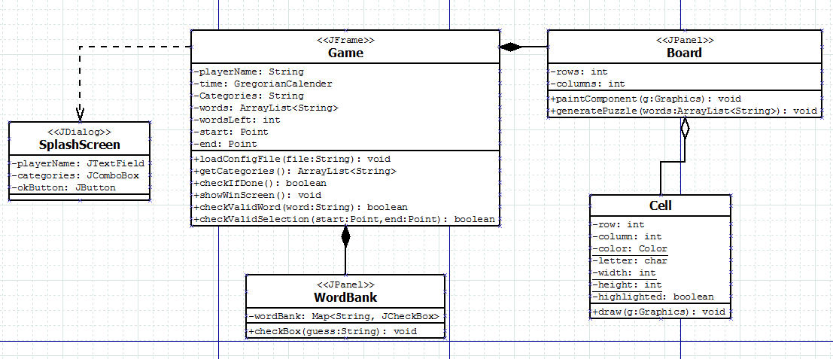
Design Process: UML

Slide 3
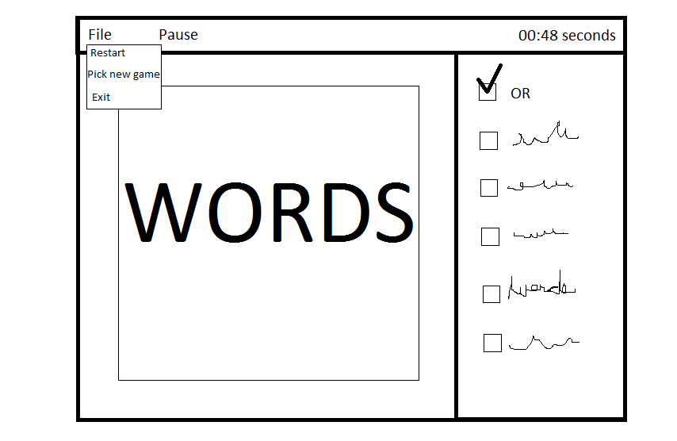
Design Process: Wireframe

Slide 4
Testing
Highlighting words
Loading words
Loading file names
Correct word
Correct selection
Word bank contains words
Game can be won

Slide 5
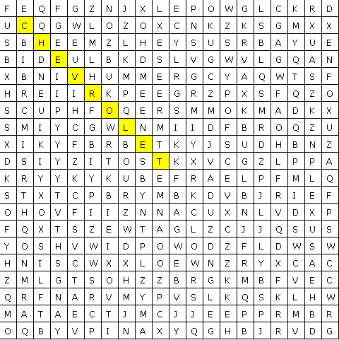

Functionality
HIGHLIGHTING
Auto Checking

Slide 6

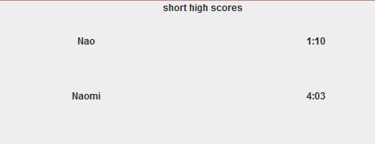
Functionality
TIMING AND HIGHSCORE BOARD

Slide 7
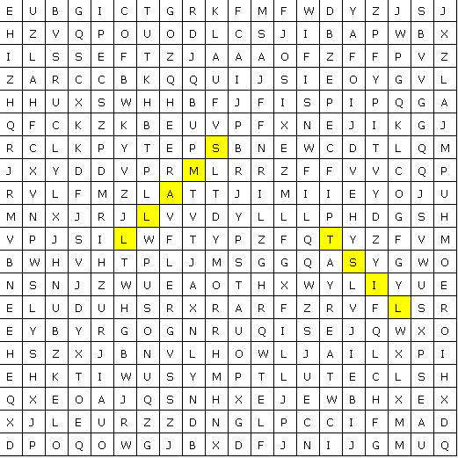
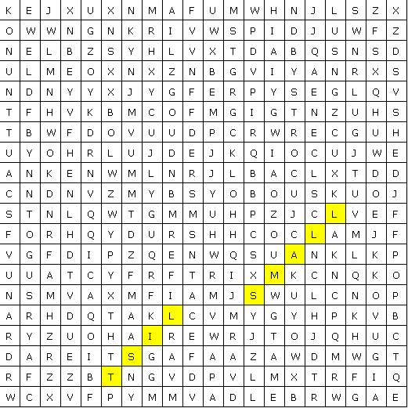
Functionality
WORDS PLACED RANDOMLY EVERY GAME

Slide 8
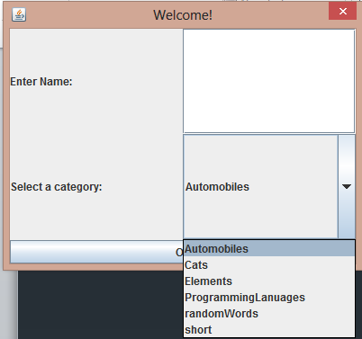
Functionality
CUSTIMIZABLE (ADD YOUR OWN LIST OF WORDS)

Slide 9
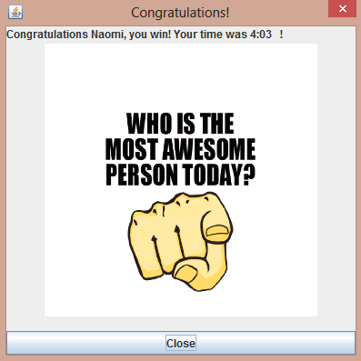
Functionality
EPIC GRAPHICS!

Slide 10
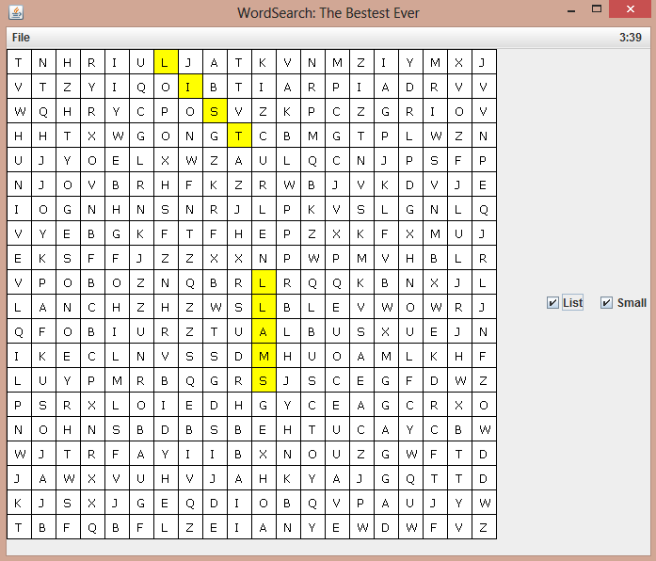
Complete Game
DEMO

